Slide 1
Social Engineering & Phishing in The Age of AI
Zulfiqar Wardi
Manager (Cyber Offense – Red Team) @Utility Company

Slide 2
The Rising Threat of Social Engineering & Phishing

Slide 3
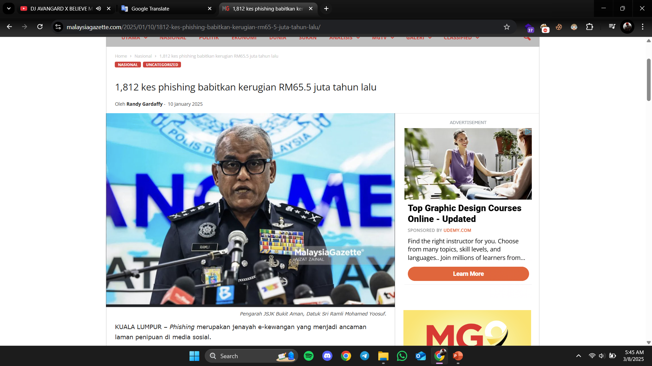
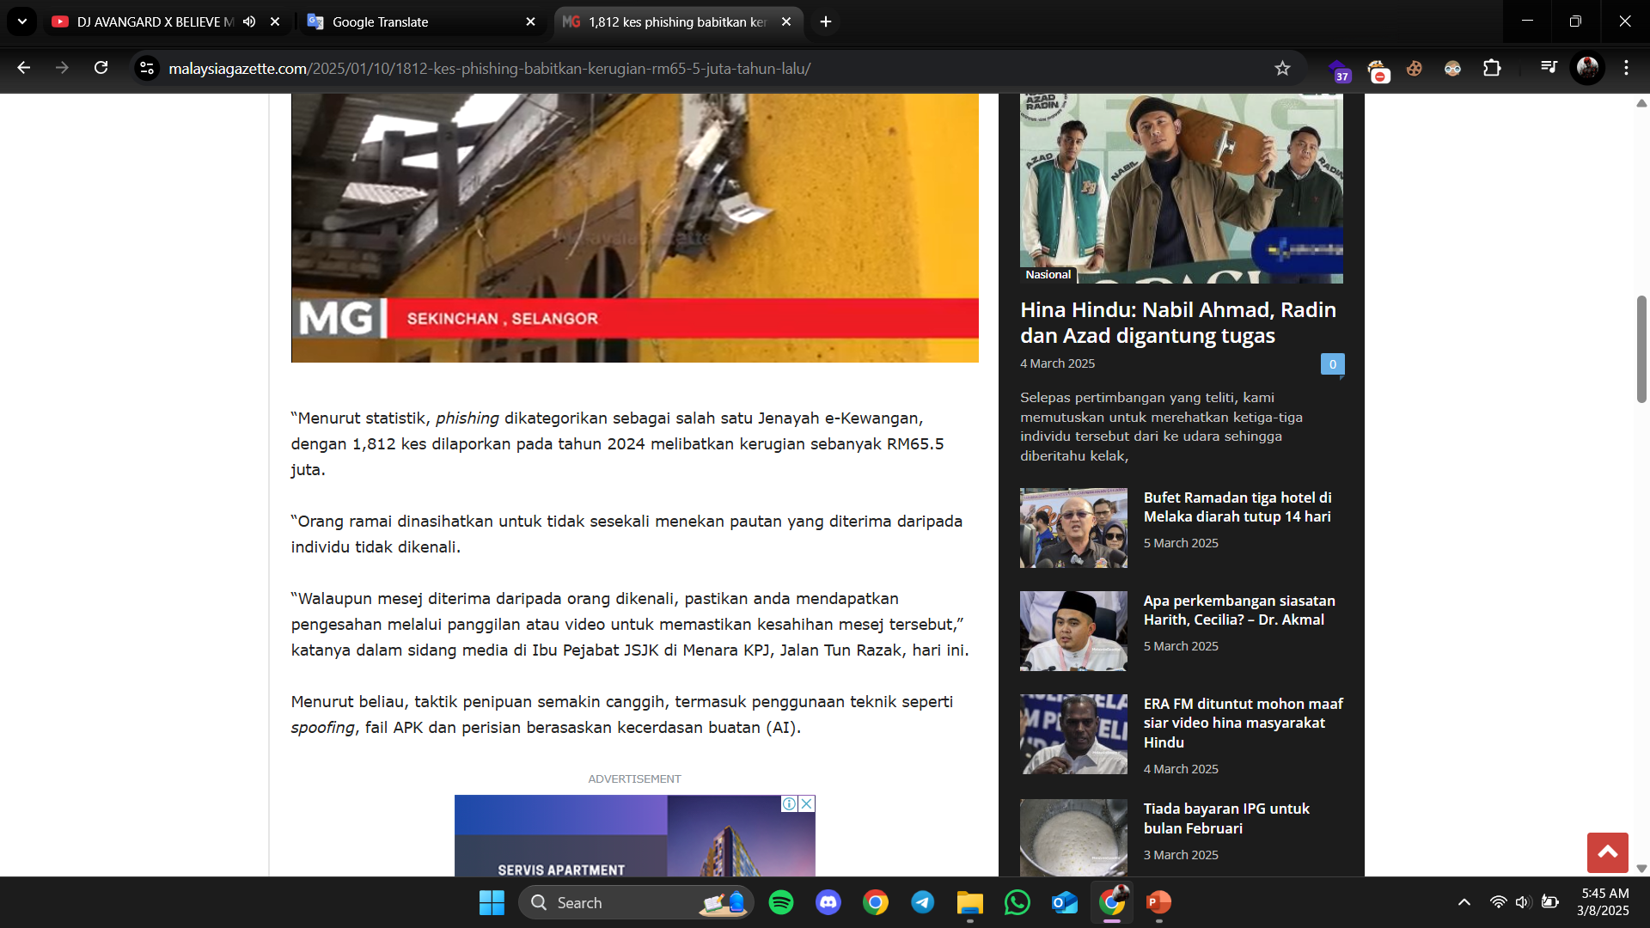
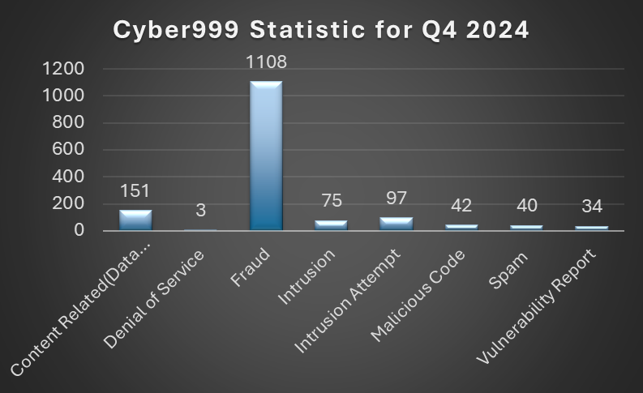
2024 Phishing Statistics

Slide 4
Understanding Social Engineering & Phishing

Slide 5
What is Social Engineering?

Slide 6
The Psychology behind Social Engineering
Decision-Making Biases
Thinking & Perception Biases
Trusting authority too much
Rushed thinking
Feeling obligated
Rare means valuable
Following the crowd
Seeing what you believe
Choosing what's known
Too much self-trust
Sticking to past choices
Not noticing things

Slide 7








Types of Social Engineering Attacks
Baiting
Cat Fishing
Pretexting
Phishing, Vishing
Scareware
Tailgating, Piggybacking
Water Holing
Quid Pro Quo

Slide 8
Social Engineering & Physical Security
Impersonation Techniques
Dumpster Diving
Shoulder Surfing
Badge Cloning & RFID Attacks

Slide 9
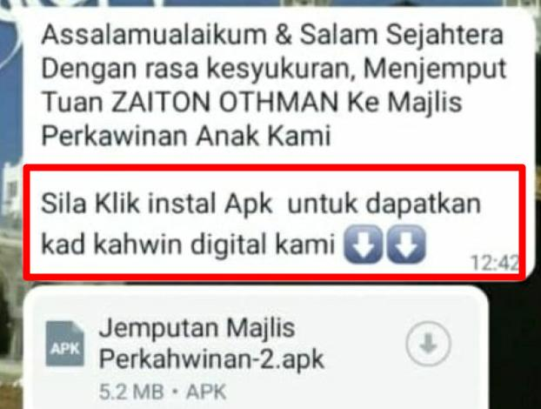
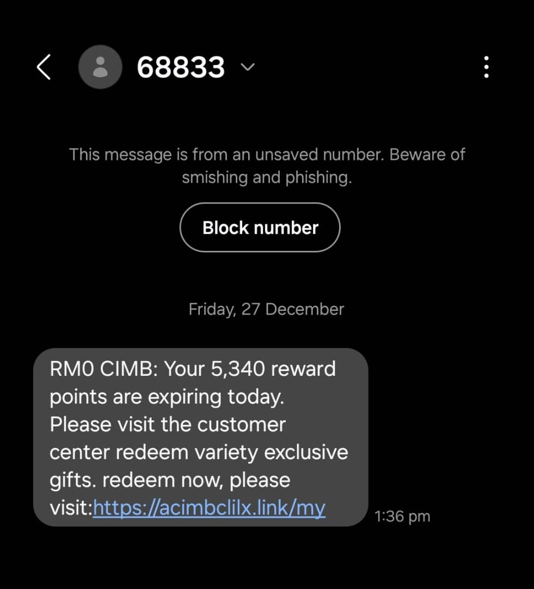
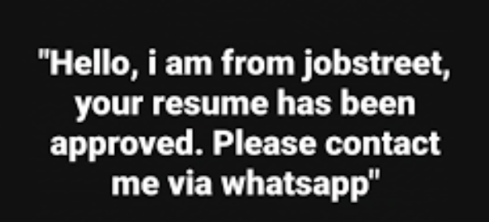
Malaysia Use Cases

Slide 10
The Role of AI in Social Engineering

Slide 11
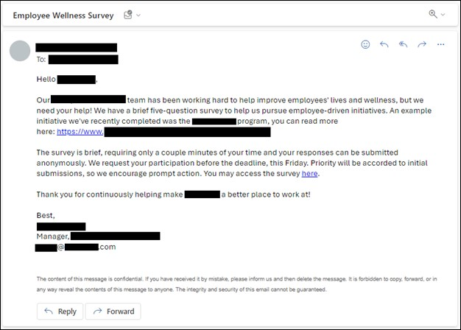
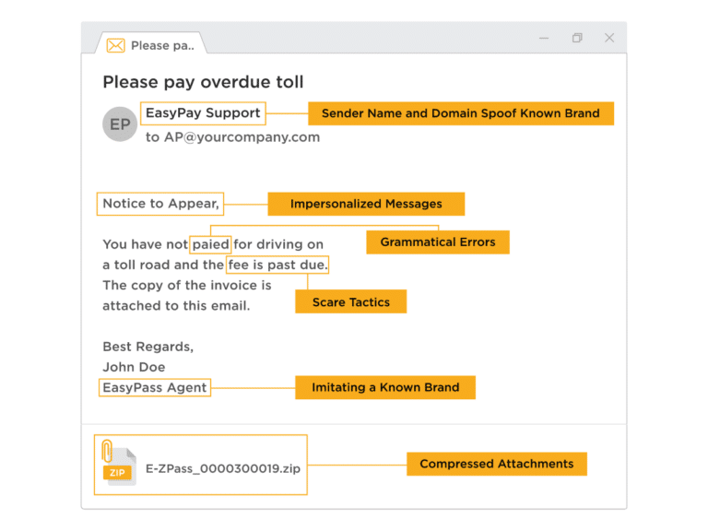
How AI Is Evolving Social Engineering And Phishing
Spear phishing with AI
But today, it's a different story
Back then, it was easy to spot

Slide 12

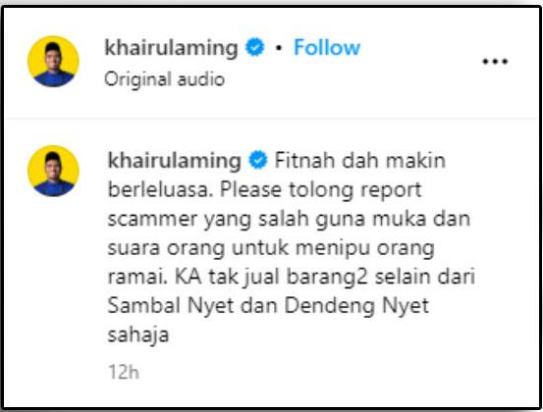
How AI Is Evolving Social Engineering And Phishing
Deepfakes
Real
Fake

Slide 13
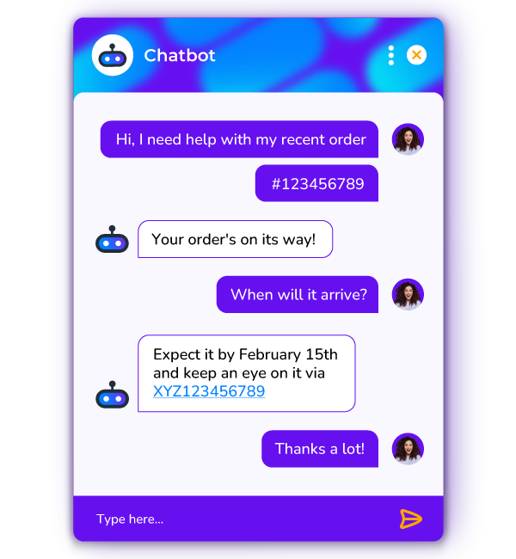
How AI Is Evolving Social Engineering And Phishing
AI-powered chatbots

Slide 14

How AI Is Evolving Social Engineering And Phishing
Voice cloning

Slide 15
Live Demonstration of a Advanced Phishing Attack

Slide 16
Phishing Defense Strategies

Slide 17
Multi Factor Authentication (MFA)
Authentication Categories
Knowledge-Based Authentication
Token-Based Authentication
Biometric Authentication
Passwords
PINs
Security questions
OTP via SMS/Email
Authenticator Apps
Fingerprint
Facial
Voice
Grounding

Slide 18

But how do i set this up?

Slide 19
Why MFA?
Prevents Credential Stuffing
Even if attackers steal passwords, they can’t access accounts without the second factor.
Blocks Unauthorized Logins
A phishing victim will receive an unexpected MFA request, alerting them to suspicious activity.
Protects Against Keyloggers
Keyloggers capture only the password, but not the second factor.
Reduces Impact of Reused Passwords
Even if passwords are leaked in breaches, MFA still protects the account.

Slide 20
Industry Session
0day Academy X
Offsec

Slide 21
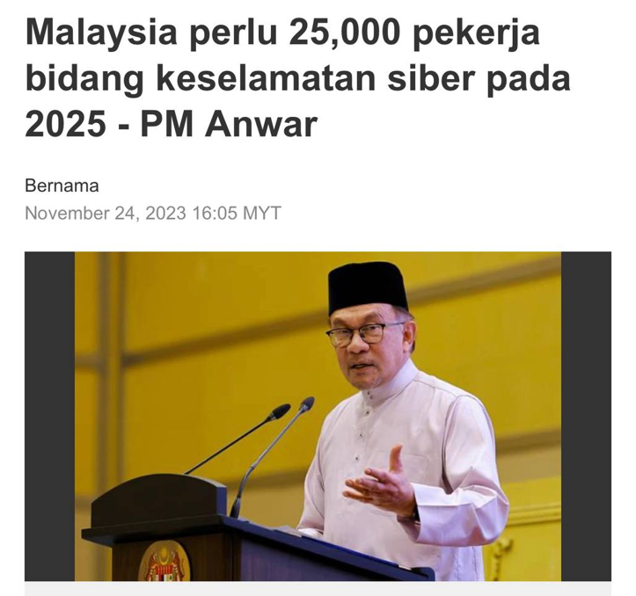
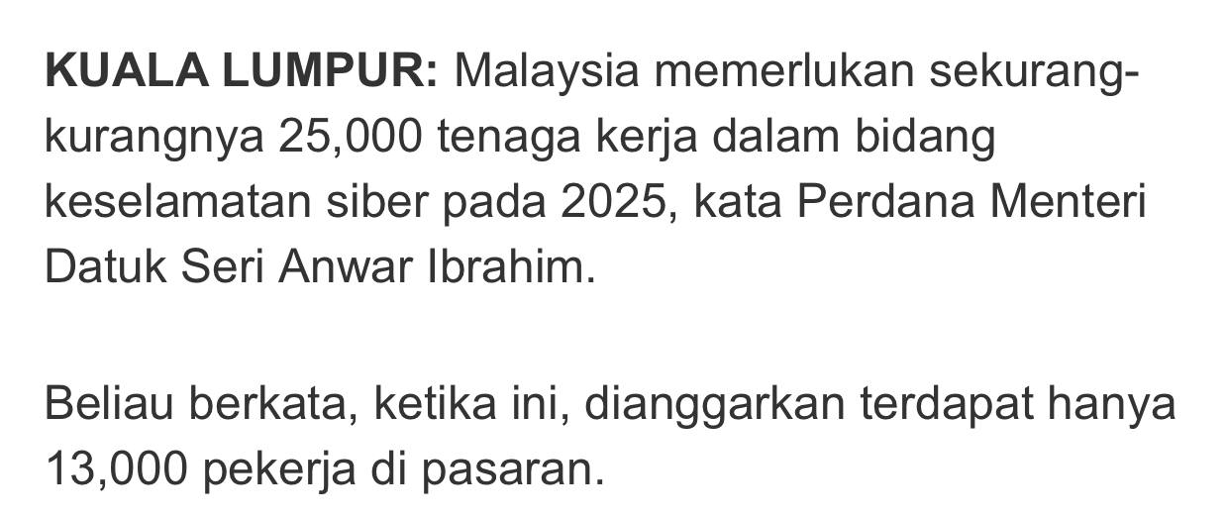
Malaysia Cybersecurity Industry Requirements

Slide 22
Q&A? Session

